Slide 1

Joint Declaration on Baku Climate Coalition for SMEs green transition

Slide 2
Joint Declaration on Baku Climate Coalition for SMEs green transition

Slide 3
Content
Overview of KOBİA.
What is Climate Change: Facts.
UNFCCC and COP.
Understanding Green and Net-Zero Transitions.
Why are SMEs so important?
Exploring Green entrepreneurship.
KOBİA: local review and international facts.
Joint Declaration: main features, main solutions, logo, implementation.
Status of the Coalition.
Q&A.

Slide 4
Overview of KOBİA?
KOBİA is a public legal entity that supports the development of SMEs, provides them with a number of services, and coordinates the services of state authorities in this area.
Number of active SME’s: 401 149
Share in the economy: 99,7%
Number of employees: 390 800
Share in employment: 44%
Value added: 20,1 Bln AZN
Share in added value: 18%
Feedback channels
Main areas of activity
Service infrastructure
Support mechanisms
Enabling business environment
• Field meetings
• Individual visits to businesses
• Public Council
• Surveys
• Entrepreneurial applications.
• Access to finance
• Access to markets
• Access to knowledge and innovation
• Access to G2B and B2B services
• SME green transition
• SME digitalization
• SME Friend Network
• SME Houses
• SME Development Centers
• Model Factory
• “Startup” certificate
• Grant Program
• Internal market research
• Access to large retail chains
• Participation in exhibitions
• Coordination Group
• New SME criteria
• Law “On the Development of Micro, Small and Medium Entrepreneurship”
• SME cluster

Slide 5

What is Climate Change: Facts
Long-term shifts in temperatures and weather patterns due to the burning of fossil
Limiting global temperature rise to no more than 1.5°C- 2°C
Carbon dioxide and methane are the main greenhouse gases
An expected increase in global temperature by 3.1°C by the end of the century
The consequences:
intense droughts and water scarcity,
severe fires,
rising sea levels, catastrophic storms and flooding,
melting polar ice,
declining biodiversity.
Major greenhouse gas emitters: Energy, industry, agriculture and waste disposal
The G20 are responsible for about 77 per cent of global greenhouse gas emissions

Slide 6
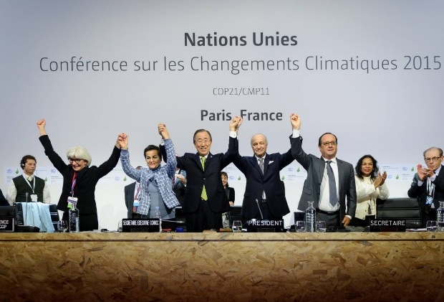
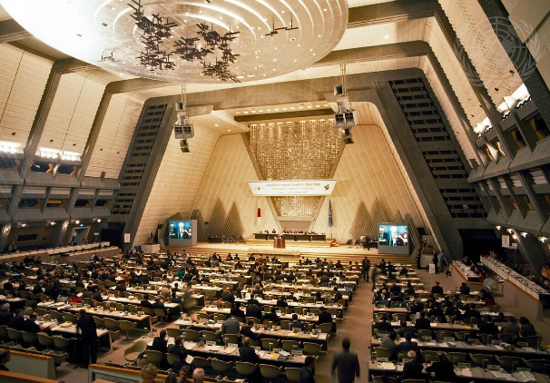
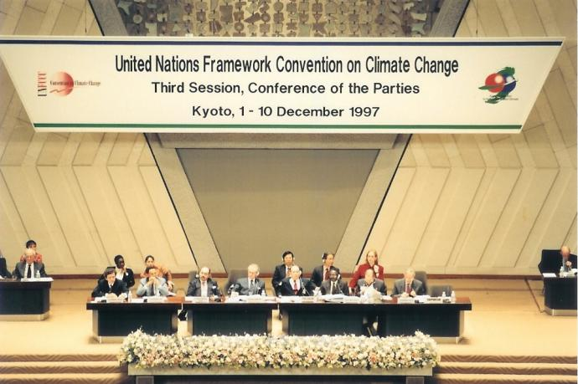
What are UNFCCC and COP?
The United Nations Framework Convention on Climate Change - a treaty adopted in 1992 entered into force in 1994
The UNFCCC has near-universal membership with 198 parties and is the parent treaty of the 1997 Kyoto Protocol and the 2015 Paris Agreement.
The UNFCCC's work currently focuses on implementing the Paris Agreement (entered into force in 2016).
Conference of the Parties (COP) is the annual UN climate change conference,
  Purpose: to assess the progress made in implementing the UNFCCC and agree on further actions
  Key Topics: greenhouse gas emissions reduction, climate finance, adaptation and technology transfer.

Slide 7
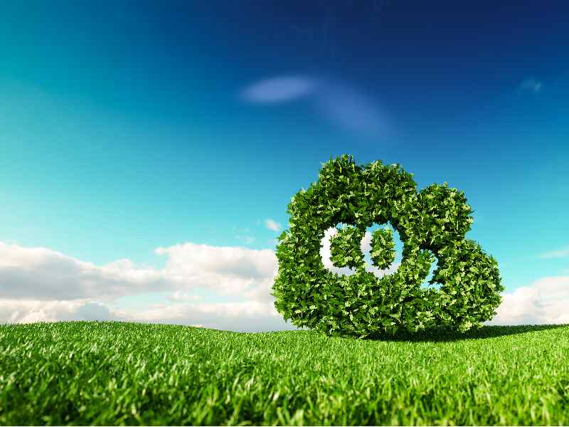
Green Transition vs. Net-Zero Transition
Green Transition
Net-Zero Transition
fundamental shift away from fossil fuels
focuses specifically on balancing GHG emissions with removals from the atmosphere.
Scope:
reducing environmental impact, combating climate change, promoting a circular economy, and fostering sustainable development.
reducing emissions (including CO2, methane, etc.) and offsetting residual emissions (carbon removal technologies or natural sinks)
Focus:
developing to renewable energy sources, energy efficiency, adopting sustainable agricultural practices, circular economy models
carbon capture and storage technologies, reforestation, and removing CO2 from the atmosphere.
Examples:

Slide 8







Why are SMEs so important?
Employment and Job Creation
In developing countries, SMEs provide over 70% of jobs.
In OECD countries, SMEs represent around 99% of all firms and generate 50% to 60% of value added on average.
Economic Growth and Diversification
SMEs contribute nearly 35%-50% of GDP.
In OECD countries, SMEs generate 50% to 60% of value added on average.
Global Supply Chains
SMEs are essential for the smooth functioning of global supply chains, acting as suppliers, distributors, and service providers.
Innovation and Competition
Community Development
Flexibility and Adaptability
Social Inclusion

Slide 9



Green entrepreneurship
Implementation of technologies for an optimal use of natural resources
Control and reduction of energy consumption and work materials
Shift to renewable sources of energy
Use of recyclable materials
Optimization of road journeys
Responsible control and treatment of waste

Slide 10




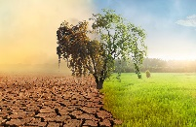

KOBİA: local review and international facts
Most Vulnerable:
  Limited Resources:
  SMEs often have fewer financial and human resources to invest in climate adaptation and mitigation strategies
  Lack of Awareness and Knowledge:
    Unaware of the specific climate risks they face or lack the knowledge to implement effective solutions.
  Marginal within ecosystem:
  Navigating a complex ecosystem government authorities, financial institutions, policymakers, regulators, fintech companies, ESG rating providers, consulting service providers, auditors, and accountants,
  Lower Capacity to Absorb Shocks:
  Less financial resilience to withstand the impacts of climate change ( property damage, supply chain disruptions)
Global warming contributor
Collective emitter:
  Individual emissions small, collectively account for 40-50% of global greenhouse gas emissions.
  SMEs are also crucial in supply chains and local communities, influencing behaviors and practices within their spheres.
Energy Consumption:
  Consume a considerable amount of commercial and industrial energy 50-70%
3

Slide 11
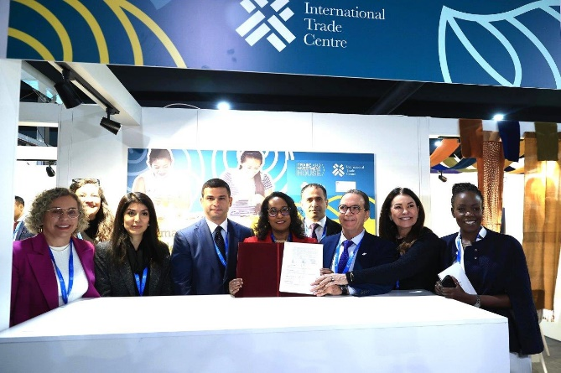
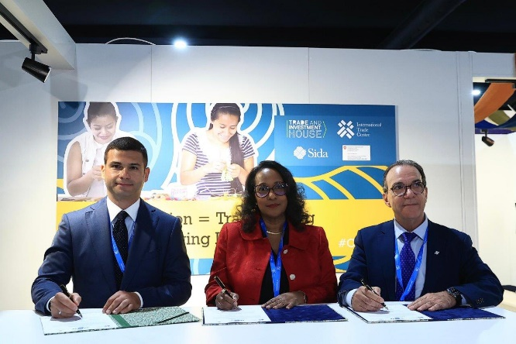
Joint Declaration: main features, main solutions
Broad coalition
Representatives of governments and states
Parliamentarians
International organizations
Chambers of commerce
Private sector
Non-governmental organizations
Science and academia
Private investors
Financial institutions, and innovation clusters
Soft solutions
  Establishing specialized training programs, research initiatives
  Facilitate technology adoption
  Integration of climate risks into business models.
  Stimulate SMEs' demand for green finance and investment, by mapping the SME financing ecosystem and enhance coordination through capacity building, policymaking measures, and requisite infrastructure.
Institutional solutions
Setting up of Green SME Resource Centers

Slide 12
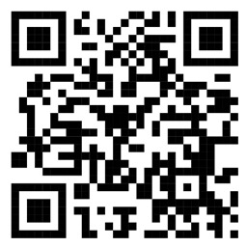

Joint Declaration: Logo
The central area is known as the “lake” which symbolizes the sources of life, purity and assembly place for humanity;
Four edges represent the key components found in nature: Water, Fire, Air and Earth;
The five distinctive colors: green, dark green, blue, orange and gold are used to reflect SDGs, namely good health and well-being, protection of terrestrial ecosystem, climate action, clean water and sanitations, sustainable cities, responsible consumption and production.
3

Slide 13
Joint Declaration: implementation
An official website (www.greensme.org) has been launched on September 09, 2024.
conference "The contribution of small and medium enterprises to the green economy“, September 9, 2024, Baku
Panel discussion “The Role of SMEs in the Green Economy” November 16, 2024, COP29, Baku
Conference “The Role of SMEs in the Sustainable Use of Water”, November 19, 2024, COP29, Baku
Conference “Baku Climate Coalition for the Green Transition of SMEs: Enhancing the Role of Women” On March 10, 2025, New York
Conference “Joint Declaration on the Baku Climate Coalition for the Green Transition of SMEs” June 2, 2025,Baku
Conference BICFIT as a catalyzer of investement, June 20, 2025, Bonn
Plans
Seminar for farmers to share the best experience available on irrigation, September 2025, Baku
AZHAB Forum, 7-8 October, Baku

Slide 14
Joint Declaration on Baku Climate Coalition for SMEs Green Transition
(www.greensme.org)
Main Features of the Initiative
Reasoning
SME - 50% of global emissions
No global green SME initiative
Strategic Goals
Build up both local and global coalition of stakeholders
Facilitate access to Climate Financing
Uniqueness
Business model approach
Global Network of Green SME Centers
Partners
№ | Countries | National authorities | № | International organizations (geographical location)
1. | Azerbaijan | 1.The Small and Medium Business Development Agency (KOBİA) | 1. | Asian Development Bank (Philippines)
2. | Belarus | 2. National Agency of the Investment and Privatization 3.Chamber of Commerce and Industry | 2. | International Trade Center (Switzerland)
3. | Brazil | 4. Brazilian Micro and Small Business Support Service (SEBRAE) | 3. | World Climate Foundation (Denmark)
4. | Kazakhstan | 5. "Damu" Entrepreunership Development Fund | 4. | Statistical, Economic and Social Research and Training Center for Islamic Countries (SESRIC) (Türkiye)
5. | Guatemala | 6. Government | 5. | Standarts and Metrology Institute for Islamic Countries (SMIIC) (Türkiye)
6. | Moldova | 7. Organization for Entrepreunership Development (ODA) | 6. | Islamic Cooperation Youth Forum (ICFY) (Türkiye)
7. | Türkiye | 8. Confederation of Turkish Tradesmen and Craftsmen (TESK) 9.The Union of Chambers and Commodity Exchanges (TOBB) | 7. | The International Network for Small and Medium Enterprises (INSME) (Italy)
8. | Vietnam | 10. National Association of Entrepreunership | 8. | UN Climate Change High-Level Champion, COP29 (USA)
8 Countries |  | 10 National authorities | 8 International organizations

Slide 15


THANK YOU!
10
AZ1000 , Azərbaycan, Bakı,
Üzeyir Hacıbəyli küçəsi, 84 (Hökumət Evi)
Tel.: (+994 12) 493 88 67
Faks: (+994 12) 492 58 95
E- poçt: office@economy.gov.az www .economy.gov.az
AZ1069, Azerbaijan, Baku,
Ziya Bunyadov 38C ave.
Tel.: (+994 12) 404 04 01
E-mail: info@smb.gov.az www.smb.gov.az
24

